Slide 1
Intelligent Traffic Light Management System
By
Joel Benjamin J

Slide 2
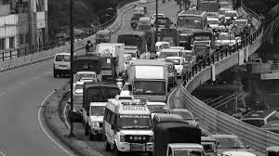
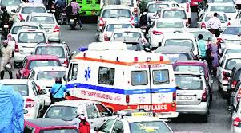
Problem Statement
Steps for Ambulance Priority.
Issues Faced more during peak then normal hours.
Nearly 30% of the Dead are due to medical delay(2023).
Technologies can be used for solving this problem.

Slide 3
System Workflow and Process
Data Collection
Open-Source Platforms
Working and Data Storage
Cloud or Local Machine
Data preprocessing and Data Cleaning
Data Categorization
Google Images
Data is stored in G-Drive
Data Labelling
Image Adjustments
Model Training and Model Prediction
Prototype
Training in Colab or LM.
Predictions Same in Colab and then Deployment
Combination of Deep Learning with Internet of Things

Slide 4


Data Collection
Data Collected through Open-Source Platforms.
Alternatively, the data is collected through other platforms and Google Images.
Collected Data needs to be proceeded like categorization and labelling.
Data needed to be checked for Image Clarity and Object Visibility.

Slide 5
Cloud vs Local for Deep Learning
Cloud Type | Reasons
AWS (EC2, Sage Maker) | Not Budget Friendly
Azure Notebook | Not Budget Friendly
Runpod | Not Budget Friendly
Google Colab | Colab Free version or Colab pro
Kaggle Notebook | Not sufficient power and lower continuous run time
GitHub | Not sufficient power and lower continuous run time.
Google Colab Free Type | Pros | Cons
CPU | High Ram | Processing Time
GPU | Faster processing speed | Lower runtime, less efficient, Longer Runtime Restoration
TPU | Faster processing speed | Lower runtime, Longer Runtime Restoration

Slide 6

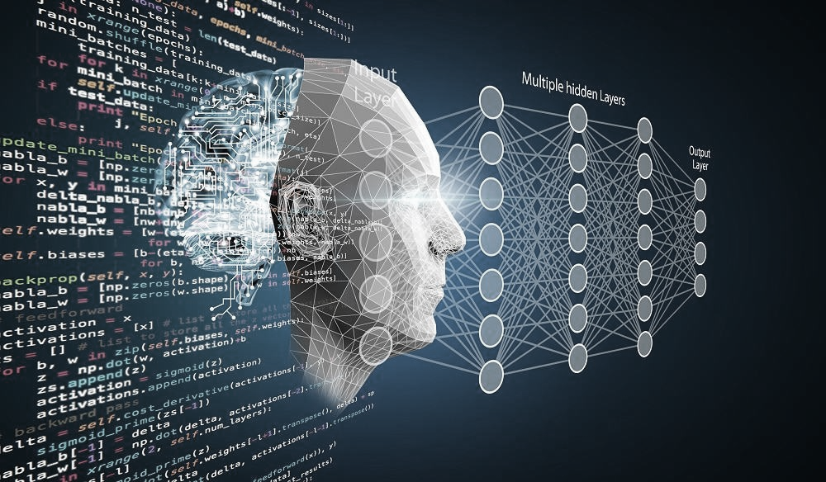
Model Training
New Models will be trained.
Pre-Trained Models that are available in TensorFlow and hugging face will be used.
Fine Tunning is Done.
Comparison of new model and pre-trained model.
Best prediction model out of 2.

Slide 7
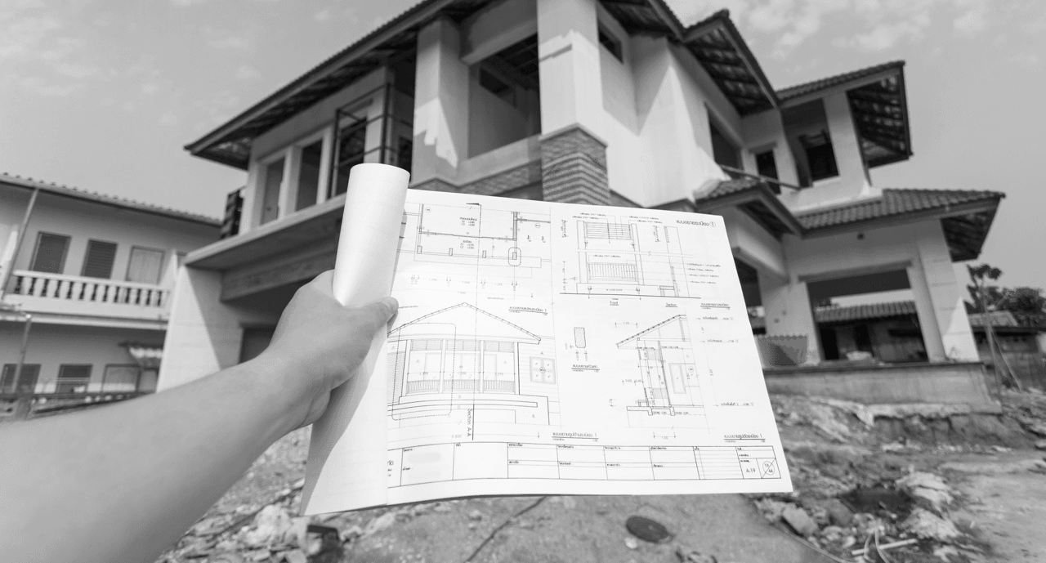
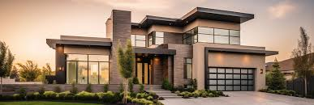
Model Deployment
For Deployment: Local Machine + VS Code.
Frontend: Streamlit, VueJS, or Jinja2.
Backend: python with FastAPI.
Testing will be done using Swagger UI and Postman
Every Record is saved into the database with Image.
Record can be used for future analysis
Prototype is Made(Arduino Microcontroller).

